Slide 1
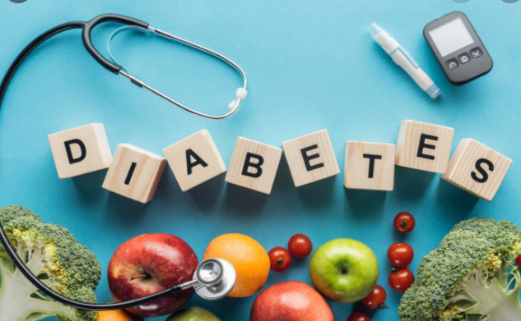
Diabetes detection using Azure
Promila Agarwal

Slide 2
Dataset from Kaggle
models to determine whether a patient admitted to an ICU has been diagnosed with a particular type of diabetes, Diabetes Mellitus. Using data from the first 24 hours of intensive care, individuals and teams will explore labeled training data for model development.
Training Model: LGBM

Slide 3
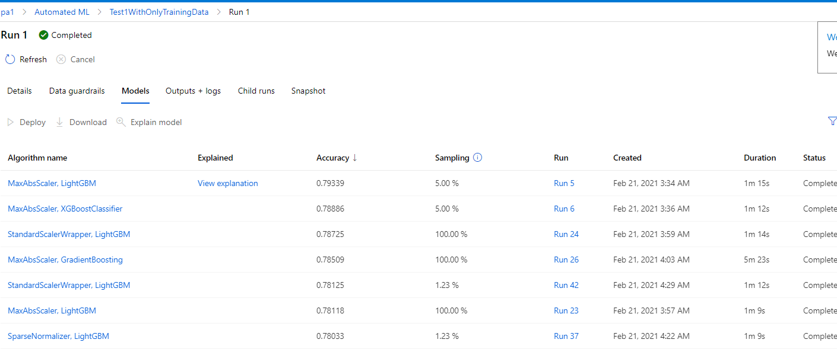

Slide 4
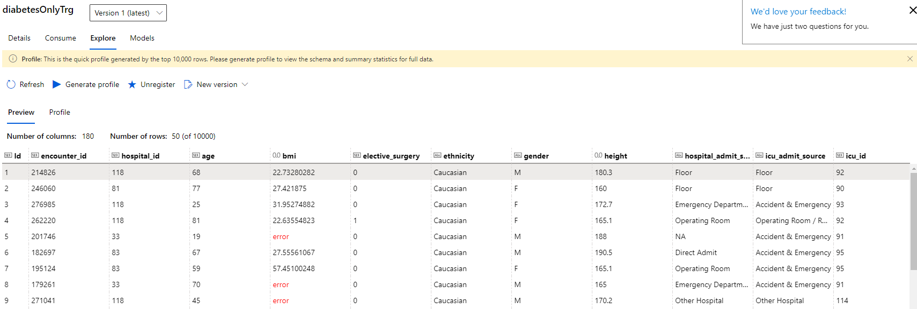

Slide 5
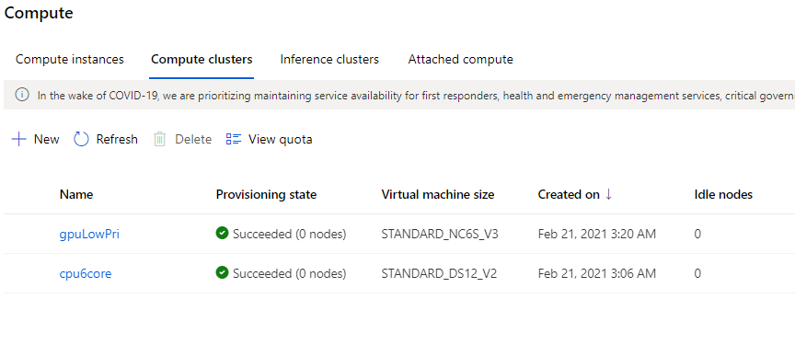

Slide 6
